Slide 1
Final Code Generation and
Code Optimization

Slide 2
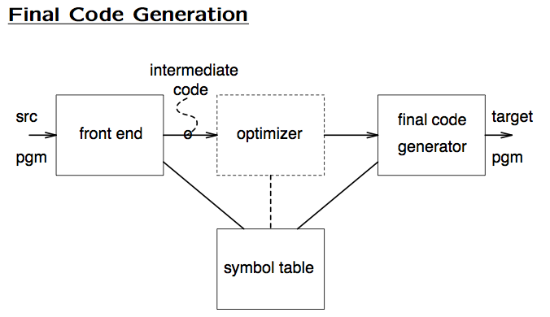

Slide 3

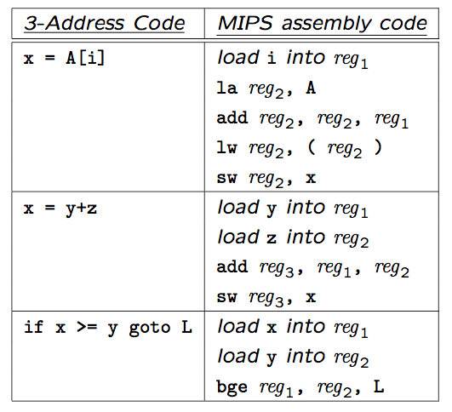

Slide 4
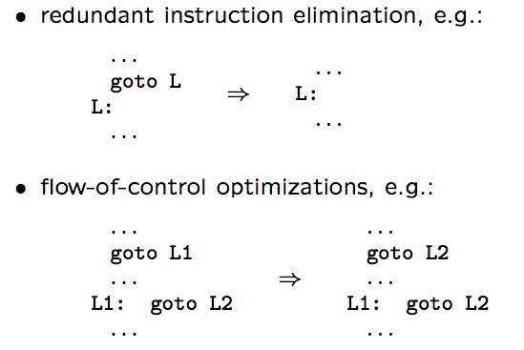

Slide 5
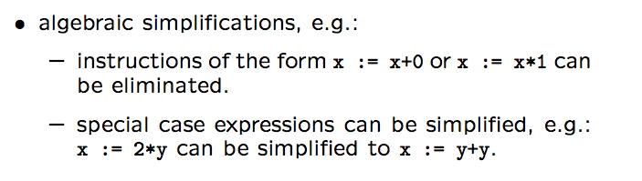

Slide 6
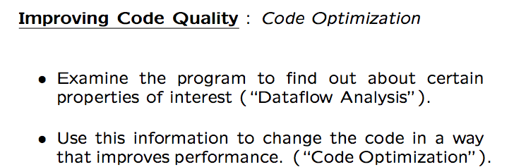

Slide 7
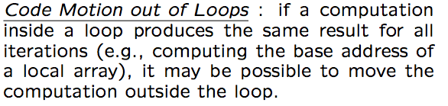
for ( i=0; i < N; i++) {
base = &a[0];
crt = *(base + i);
}
base = &a[0];
for ( i=0; i < N; i++) {
crt = *(base + i);
}
original code
optimized code

Slide 8
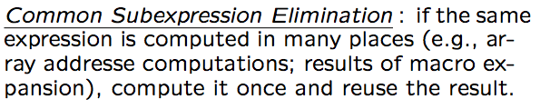
tmp = &a[0]+offset;
e1 = *(tmp +i);
e2 = *(tmp +j);
e1 = *(&a[0]+offset +i);
e2 = *(&a[0]+offset +j);
original code
optimized code

Slide 9

y = …
x = y;
b = x / 2;
y = …
b = y / 2;
original code
optimized code

Slide 10

if (1)
x = y;
else
x = z;
x = y;
original code
optimized code

Slide 11
Basics of Code Optimization and Machine Code Generation
Construct Control Flow Graph (CFG) Representation for the Intermediate Code
  → Algorithm for building CFG
Perform Data Flow Analysis to Collect Information Needed for Performing Optimizations
  → Variable Liveness Analysis
Perform Optimizations and Generate Machine Code
  → Algorithm for Register Allocation

Slide 12
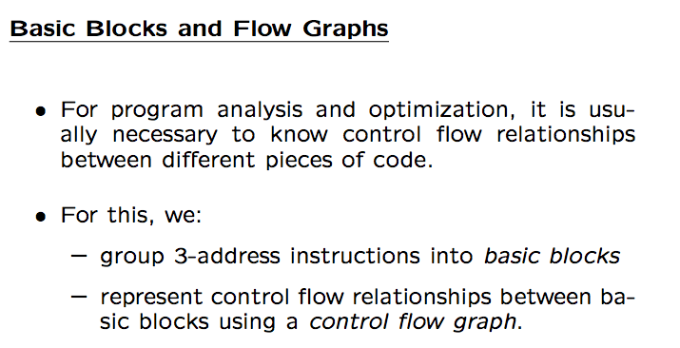

Slide 13
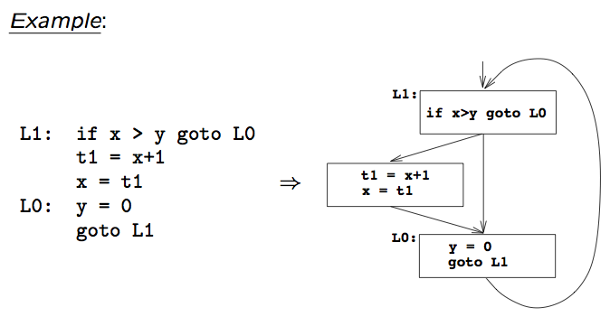

Slide 14
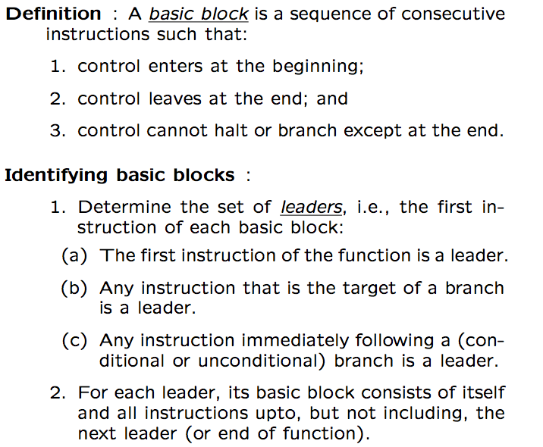

Slide 15

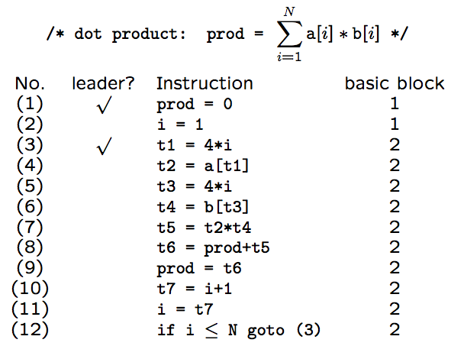

Slide 16
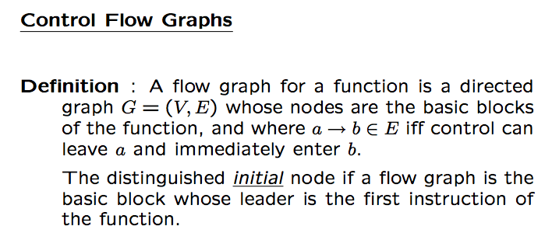

Slide 17
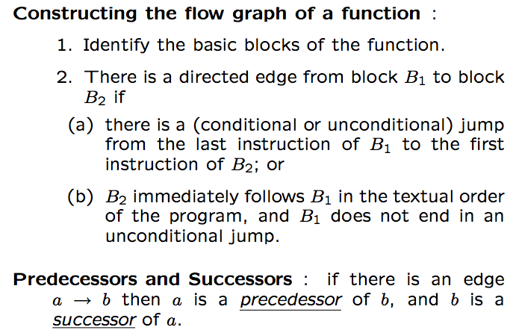

Slide 18

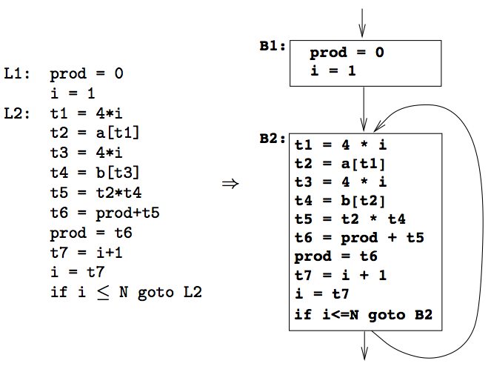

Slide 19
Rationale
  A value in a register can be accessed much more efficiently than one in memory
Liveness Analysis to build Live Ranges
  Identifies durations for which each variable could benefit from using a register
Perform Register Allocation
  CPU has limited registers → keep frequently used values in registers

Slide 20
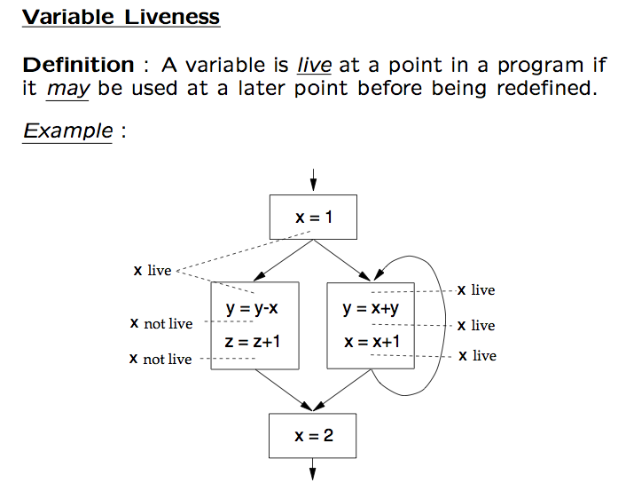

Slide 21
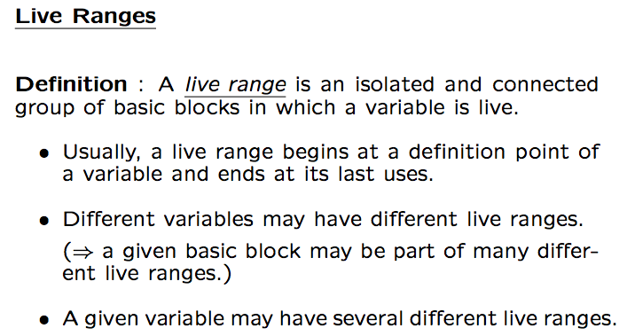

Slide 22
2 Live Ranges of x
1 Live Range of y
Start
Start
define x
define y
define x
define y
use x
use x
use x
use y
use x
use y
use x
define x
use y
use x
define x
use y
use x
use x
use x
use x
End
End

Slide 23
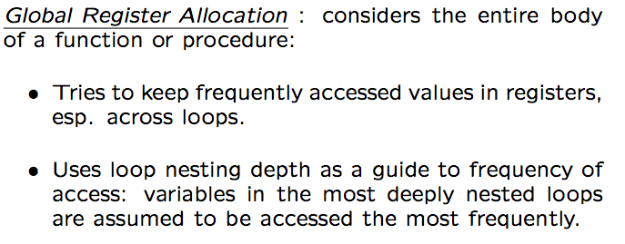

Slide 24
read A
D = A+1
read B
D = D+B
D = A+1
read C
D = D+C
print A,D
A
R₁
R₂
R₃
Register Interference Graph
nodes: live ranges
edges: live ranges overlap
B
C
k-coloring, where k is
the number of registers
D

Slide 25
Attempt n-coloring
Color the interference graph using R colors where R is the number of registers.
Observation: If there is a node n with < R neighbors, then no matter how the neighbors are colored, there will be at least one color left over to color node n.
Remove n and its edges to get G’
Repeat the above process to get G’’
…….
If an empty graph results, R-coloring is possible. Assign colors in reverse of the order in which they were removed.

Slide 26
Attempt Coloring Contd..
Input: Graph G
Output: N-coloring of G
While there exists n in G with < N edges do
Eliminate n & all its edges from G; list n
End while
If G is empty the
for each node i in list in reverse order do
Add i & its edges back to G;
choose color for i
endfor
End if

Slide 27
A
A
B
C
{empty graph}
D
D
R₁
R₂
R₃
A
A
R₁
R₁
{empty graph}
B
C
R₃
R₃
D
D
R₂
R₂

Slide 28
Liveness Analysis and Live Range Construction
Global Analysis
  → Finds what variables are live at basic block boundaries
Local Analysis
  → Finds what variables are live at all points within basic blocks
Build Live Ranges

Slide 29
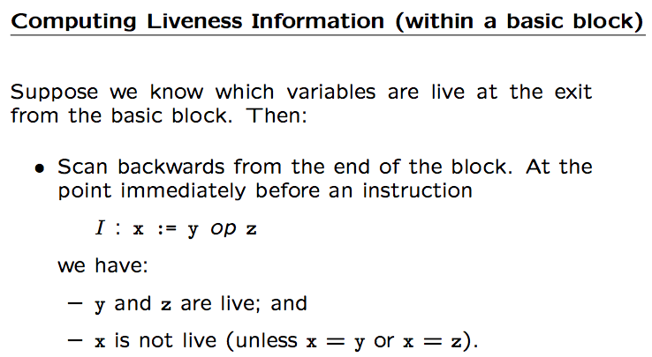
{ }
Input a
Input b
y = a + b
y = y – 1
x = a + 1
Print x + y
{ a }
{ a, b }
{ y, a }
{ y, a }
{ x, y }
{ }

Slide 30
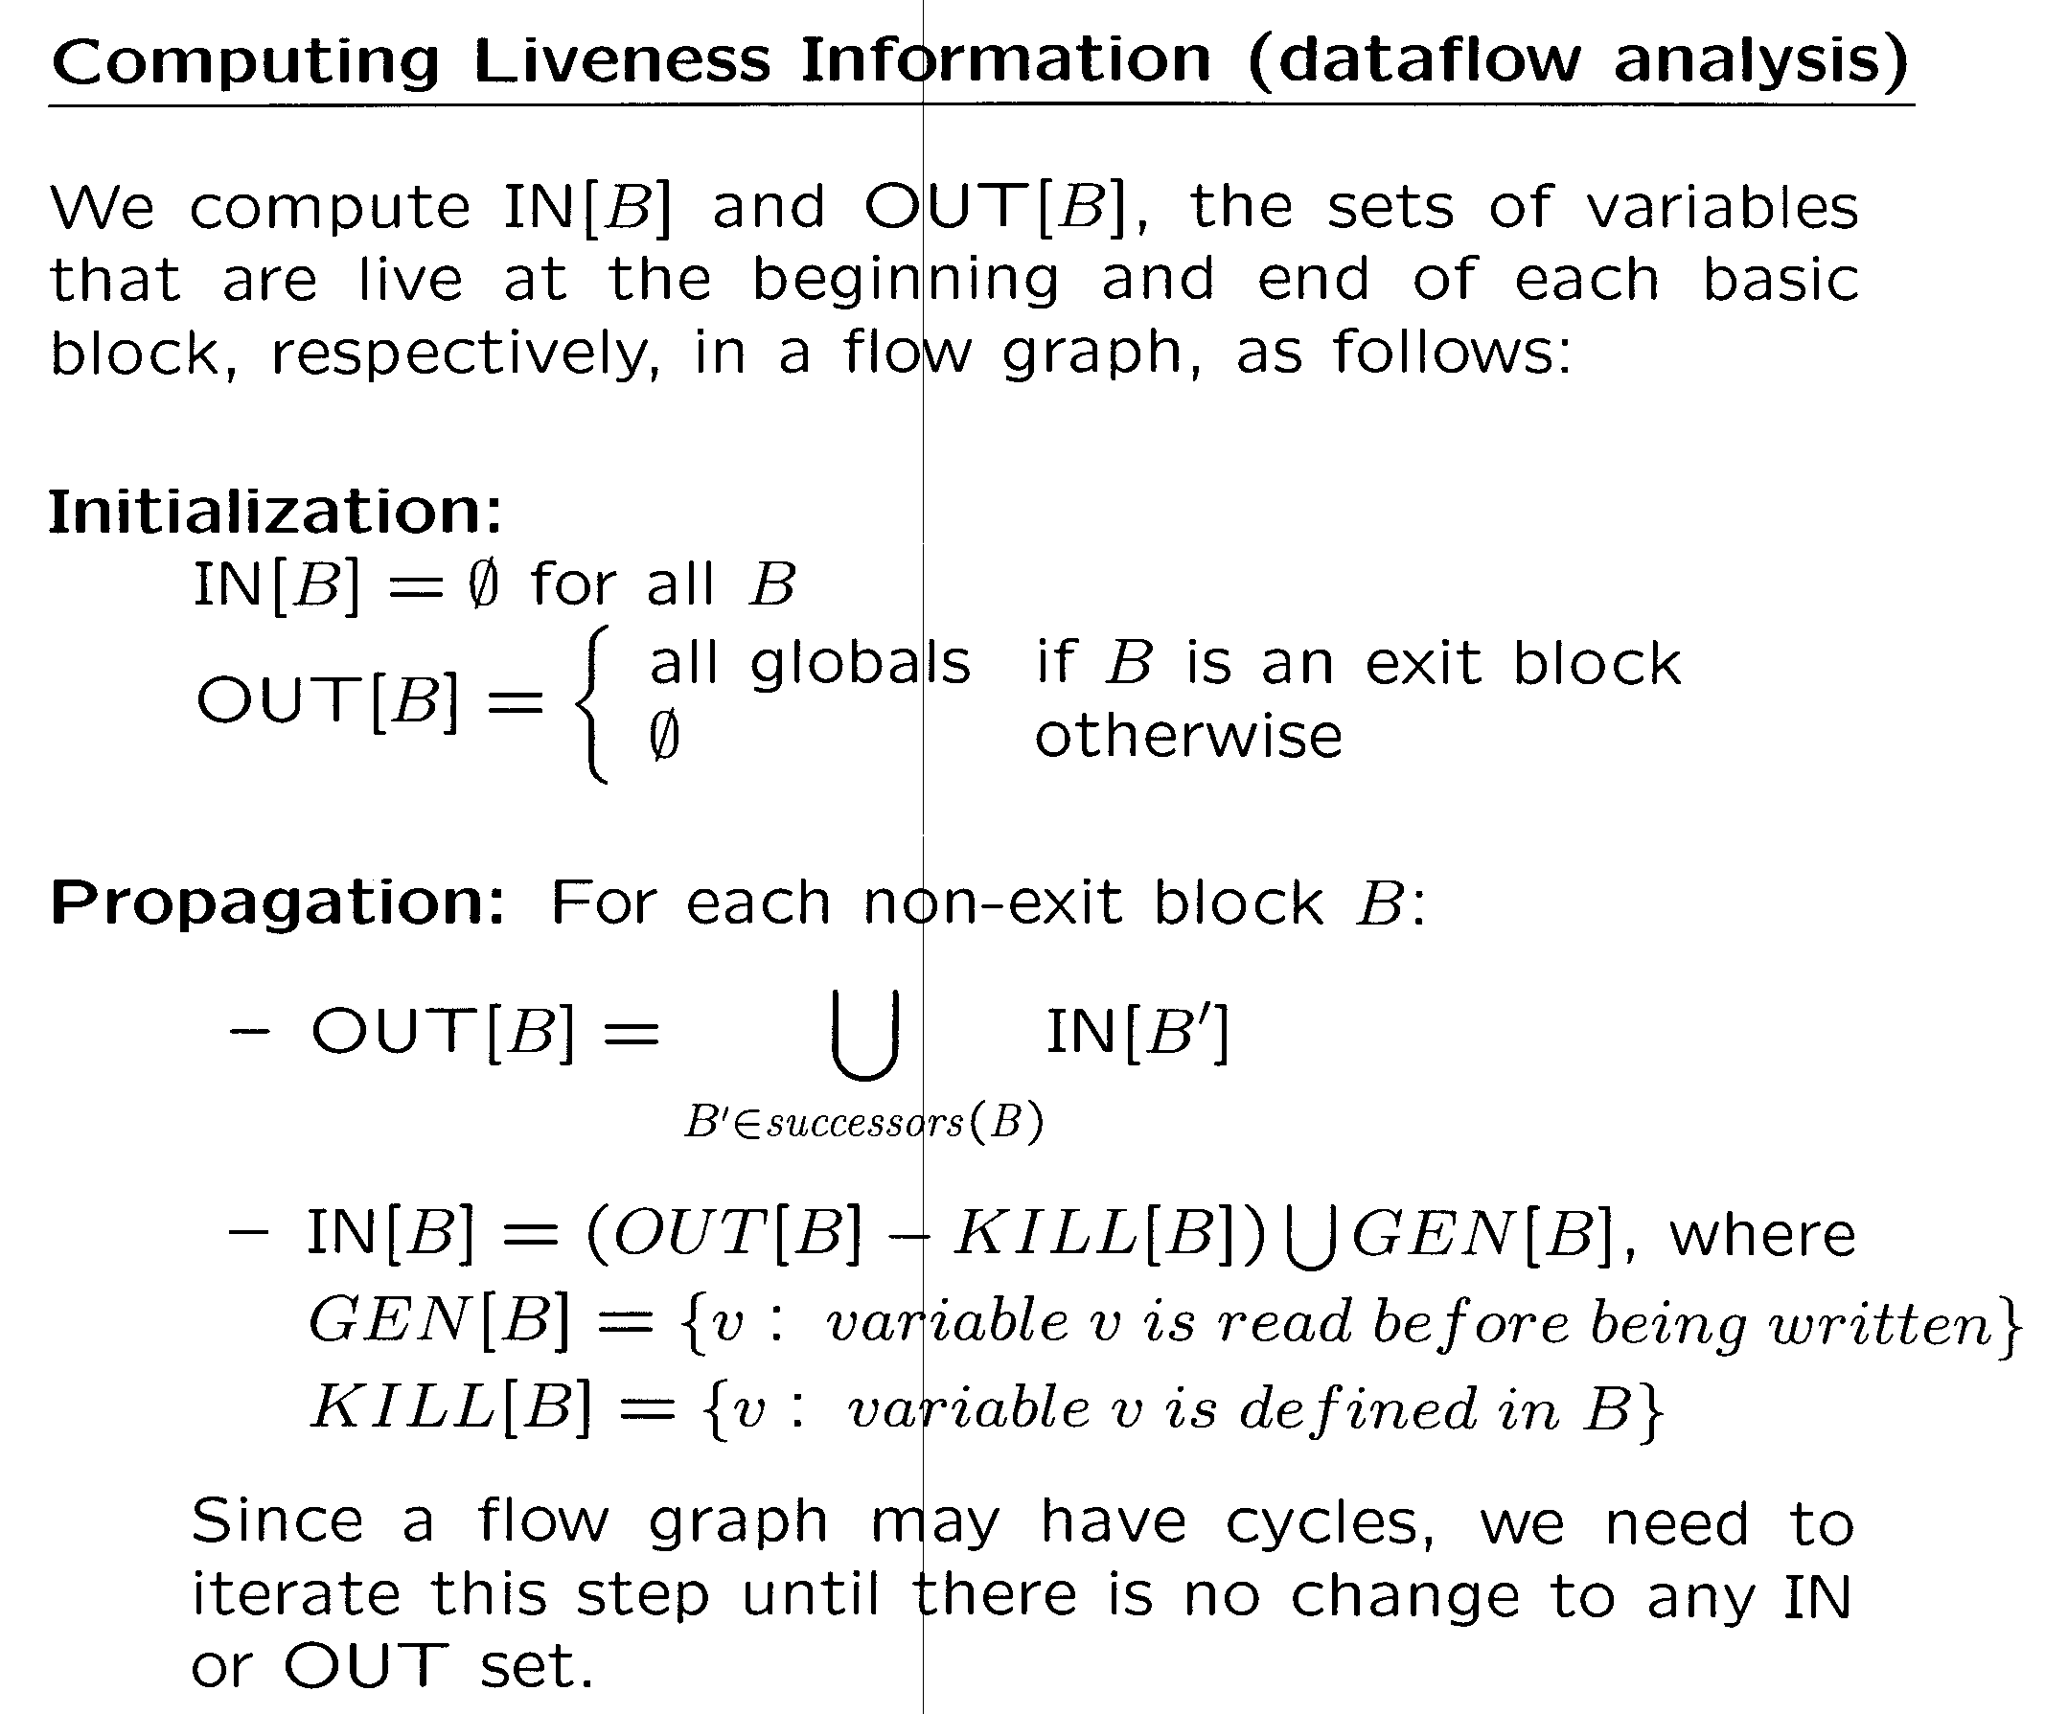
of a function
other than main()

Slide 31
Start
define x
define y
GEN[1] = -
KILL[1] = x,y
1
2
use x
GEN[2] = x
KILL[2] = -
GEN[3] = x
KILL[3] = -
3
use x
use y
4
GEN[4] = y
KILL[4] = -
GEN[5] = x
KILL[5] = -
5
use x
define x
use y
6
GEN[6] = y
KILL[6] = x
GEN[7] = x
KILL[7] = -
7
use x
use x
GEN[8] = x
KILL[8] = -
8
End

Slide 32
IN[1] = (OUT[1] – KILL[1]) U GEN[1] = OUT[1] - {x,y}
OUT[1] = IN[2] U IN[4]
IN[2] = (OUT[2] – KILL[2]) U GEN[2] = OUT[2] U {x}
OUT[2] = IN[3] U IN[4]
IN[3] = (OUT[3] – KILL[3]) U GEN[3] = OUT[3] U {x}
OUT[3] = IN[3] U IN[5]
IN[4] = (OUT[4] – KILL[4]) U GEN[4] = OUT[4] U {y}
OUT[4] = IN[5] U IN[6]
IN[5] = (OUT[5] – KILL[5]) U GEN[5] = OUT[5] U {x}
OUT[5] = {}
IN[6] = (OUT[6] – KILL[6]) U GEN[6] = (OUT[6] – {x}) U {y}
OUT[6] = IN[7] U IN[8]
IN[7] = (OUT[7] – KILL[7]) U GEN[7] = OUT[7] U {x}
OUT[7] = {}
IN[8] = (OUT[8] – KILL[8]) U GEN[8] = OUT[8] U {x}
OUT[8] = IN[8]
OUT(b) = U_{s in Succ(b)} IN(s)
IN(b) = (OUT(b) – KILL(b)) U GEN(b)

Slide 33
IN[1] = OUT[1] - {x,y}
OUT[1] = IN[2] U IN[4]
IN[2] = OUT[2] U {x}
OUT[2] = IN[3] U IN[4]
IN[3] = OUT[3] U {x}
OUT[3] = IN[3] U IN[5]
IN[4] = OUT[4] U {y}
OUT[4] = IN[5] U IN[6]
IN[5] = OUT[5] U {x}
OUT[5] = {}
IN[6] = (OUT[6] – {x}) U {y}
OUT[6] = IN[7] U IN[8]
IN[7] = OUT[7] U {x}
OUT[7] = {}
IN[8] = OUT[8] U {x}
OUT[8] = IN[8]
IN[1] | {} | {} | {} | {}
OUT[1] | {} | {x,y} | {x,y} | {x,y}
IN[2] | {} | {x,y} | {x,y} | {x,y}
OUT[2] | {} | {x,y} | {x,y} | {x,y}
IN[3] | {} | {x} | {x} | {x}
OUT[3] | {} | {x} | {x} | {x}
IN[4] | {} | {x,y} | {x,y} | {x,y}
OUT[4] | {} | {x,y} | {x,y} | {x,y}
IN[5] | {} | {x} | {x} | {x}
OUT[5] | {} | {} | {} | {}
IN[6] | {} | {y} | {y} | {y}
OUT[6] | {} | {x} | {x} | {x}
IN[7] | {} | {x} | {x} | {x}
OUT[7] | {} | {} | {} | {}
IN[8] | {} | {x} | {x} | {x}
OUT[8] | {} | {} | {x} | {x}

Slide 34
OUT(b) = U_{s in Succ(b)} IN(s)
IN(b) = (OUT(b) – KILL(b)) U GEN(b)
Start
-
define x
define y
GEN[1] = -
KILL[1] = x,y
IN
1
……
x,y
OUT
x,y
2
use x
GEN[2] = x
KILL[2] = -
x,y
x
x,y
GEN[3] = x
KILL[3] = -
3
use x
use y
4
GEN[4] = y
KILL[4] = -
x
x,y
x
y
GEN[5] = x
KILL[5] = -
5
use x
define x
use y
6
GEN[6] = y
KILL[6] = x
-
x
x
x
GEN[7] = x
KILL[7] = -
7
use x
use x
GEN[8] = x
KILL[8] = -
-
x
8
End

Slide 35
2 Live Ranges of x
1 Live Range of y
Start
Start
define x
define y
define x
define y
use x
use x
use x
use y
use x
use y
use x
define x
use y
use x
define x
use y
use x
use x
use x
use x
End
End

Slide 36
Algorithm for solving data flow equations:
For each block B do
if B is the exit block then
OUT[B] = set of global variables
IN[B] = (OUT[B] – KILL[B]) U GEN[B]
else
OUT[B] = IN[B] = { }
endif
Endfor
DONE = false
While not DONE do
DONE = true;
for each B which is not the exit block do
new = U IN[B’]
B’ ε SUCC(B)
if new != OUT[B] then
DONE = false;
OUT[B] = new;
IN[B] = (OUT[B] – KILL[B]) U GEN[B]
Endif
Endfor
Endwhile

